Slide 1
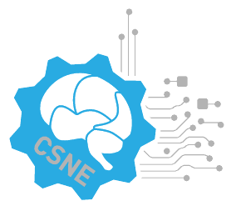

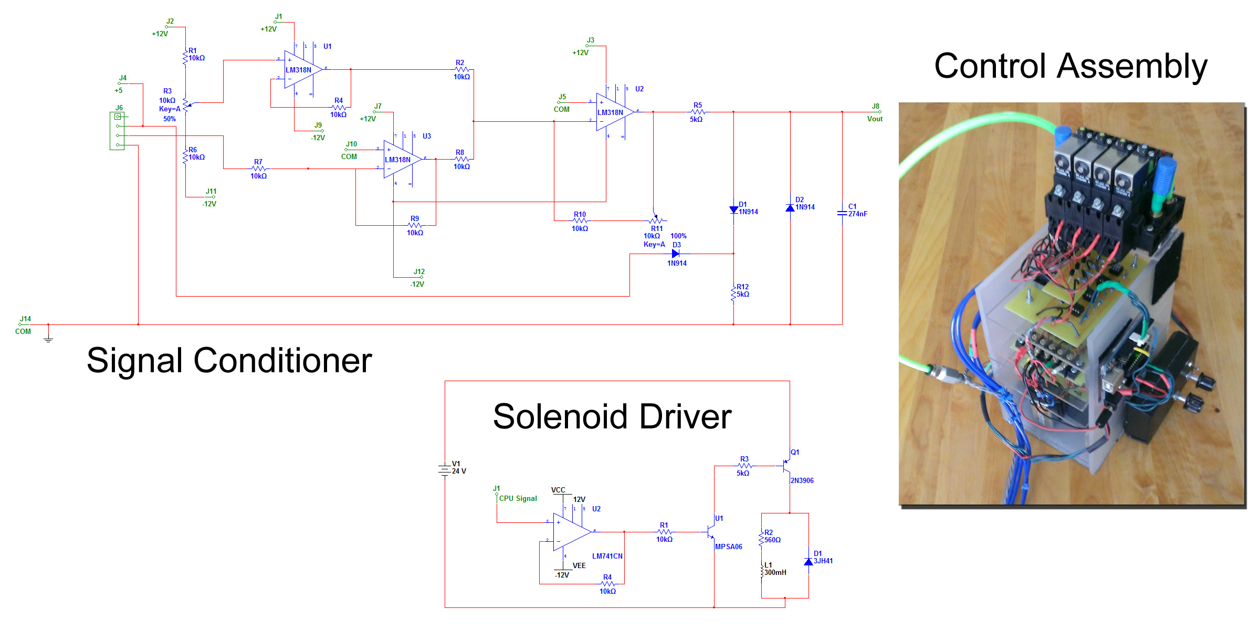
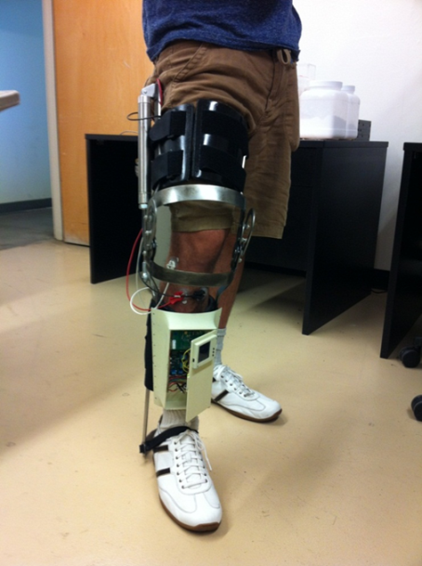
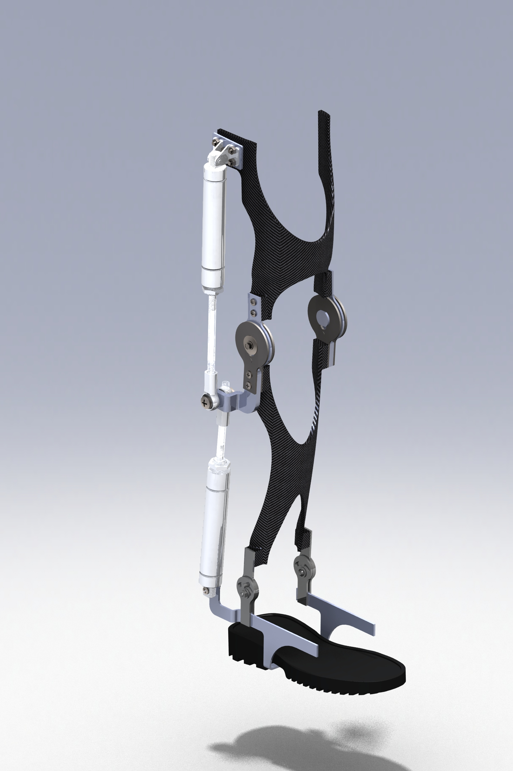
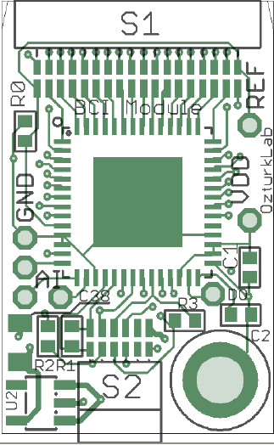
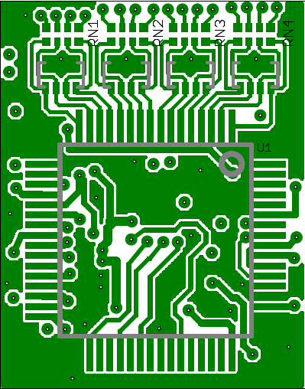
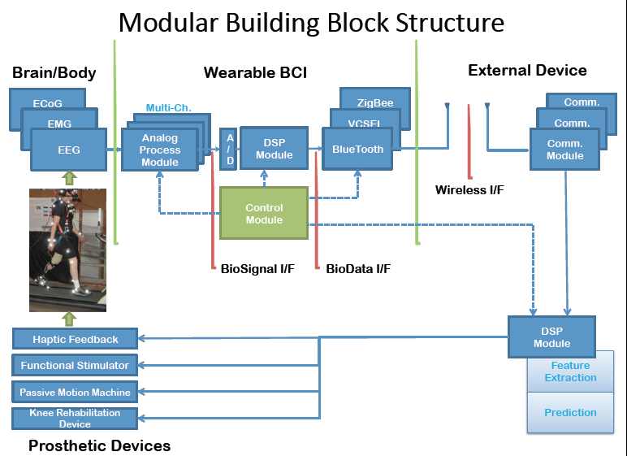
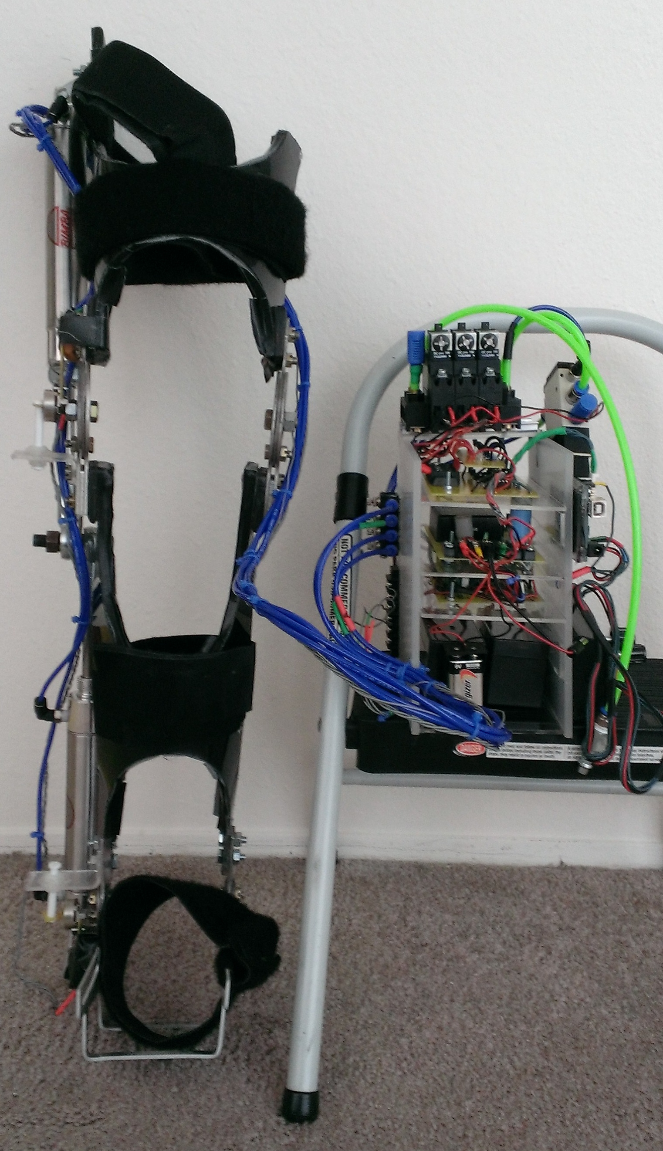
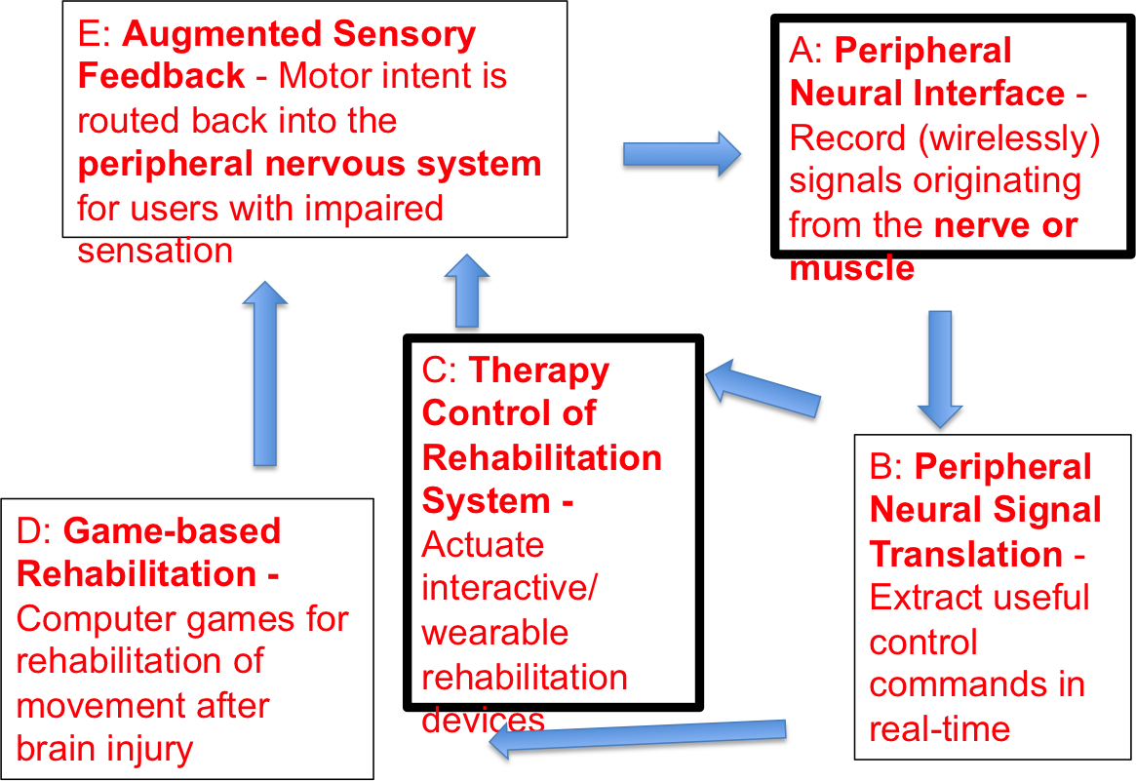



An Active Connected Knee Rehabilitation Device
Yusuf Ozturk, Kee Moon, Yi Su, Yeongjee Chung , Depts. of Electrical Engr. & Dept. of Mechanical Engr., SDSU, San Diego, CA
Chet Moritz, Departments of Rehabilitation Medicine and Physiology & Biophysics, U of Washington, Seattle, WA
Introduction
This project aims to develop the technology and components for Neuro-rehabilitation Systems Testbed
The project is developing rehabilitation systems to improve function of walking gait movement after brain injury.
Results
Robotic walking gait controller
Wireless optical muscle and movement sensor
Robotic walking gait device design
Conclusions
A closed loop walking gait rehabilitation solution with the doctor/therapist in the loop monitoring the progress of the patient and administering active robotic device configuration parameters was developed.
A wearable wireless device for measuring muscle activity and muscle tension is developed.
The novel optical muscle activity sensor detects muscle tension and correlates with limb position.
A low power wireless protocol is developed to monitor the sensor remotely.
Drawing
SolidWorks
Prototype 1
Wireless 16 channel and 8 channel differential biosignal interface modules
Methods
EMG/optical muscle sensor-driven robotic rehabilitation devices to solve the problems of walking
Wireless network collecting sensory data from EMG/optical muscle and movement sensors on the patient
Transmission to doctor’s office on a secure channel
Fabricated pneumatic robotic walking gait device prototype
Neuro-rehabilitation Systems Block Diagram (Walking Gait)
Prototype 2 with Control Systems

